Slide 1
Ch4 PMBOK 6th ED
All Photos, unless otherwise noted, come from ClipArt.com

Slide 2
Legal Stuff
“As is”
No warranty with respect to fitness of use.
No responsible for incidental or consequential damages
Use at your own risk

Slide 3
Integration Project Management is…
”…the processes and activities to identify, define, combine, unify, and coordinate” various Project Management activities.” (p.69)

Slide 4
Main ideas…
Resource allocations
Balancing competing needs
Examining any alternatives
Tailoring
Managing cross area dependencies

Slide 5
Key concepts (p. 72)
Coordinate deliverables
Develop project plan
Ensuring the right resources are accessible to the team.
Monitor and control to keep project plan viable
Oversee changes to project plan
Keep the project on track
Communicating with stakeholders (especially actual progress vs. expected)

Slide 6
Emergent Changes(p. 73)
Automated tools (MS Project, Jira, etc.)
Expanding roles of the PM
Agile + PM = Hybrid

Slide 7
4.1 Develop Project Charter

Slide 8
Develop Project Charter (p. 75)
“…the process of developing a document that formally authorizes the existence of a project and provides the project manager with the authority to apply organization resources to project activities.”
Usually internally initiated, and written by the PM (BV)

Slide 9
Statement Of Work (bv)
A contract for going outside the company or organization. (bv)

Slide 10
The PM Charter…
…establishes the relationship between the performing and requesting organization. (p. 77)

Slide 11
Business Case Main Points (p.77)
Idea
Cost justification (NPV)
Due date

Slide 12
Business Case Considerations (p. 78)
Market demand
Organizational need
Customer request
Technology advancements
Legal requirements
Ecological/social impacts

Slide 13
Agreements (p. 78)
Service level agreement(SLA): (If you can’t get one, just expect people not to live up to expectations – BV)
Memorandums of understanding
Letters of agreements
Verbal promises
Trust
Miss-remembering
Altering terms during execution

Slide 14
Data Gathering
Brain Storming*
Focus groups **
Interviews ***
Design Thinking
.* https://www.youtube.com/watch?v=9K8W4ooygUU. BNET/200k views/3.5min
https://www.youtube.com/watch?v=YXZamW4-Ysk&t=12s IBM/77k views/8.5min
.**
https://www.youtube.com/watch?v=3TwgVQIZPsw. (TED-EDU) 360K/4.6 min
.*** https://www.youtube.com/watch?v=4eOynrI2eTM .5M/5 min
**** https://www.youtube.com/watch?v=_WI3B54m6SU .5M 3.5 min

Slide 15
Interpersonal Team Skills
Meeting management
PAL(Purpose, Agenda, Length)
Start on time
Minutes
Action Items/Follow Up

Slide 16
Develop Project Charter Outputs (p. 81)
Purpose of the project or effort
SMART goals/KPIs
High level requirements
What is included
What is not included
Key deliverables
Known risks
Due dates
Key customer identification (stakeholders)
Definition of success
ID of Project Manager and who is “sponsor”
Assumptions
Signature of sponsor.
Cost/Benefit (taken from business case)

Slide 17
4.2 Develop Project Management Plan (p. 82)

Slide 18
Friendly Reminder: The Project Plan identifies how the project is to be: (P.83)
Executed
Monitored and controlled
Closed

Slide 19
Project management plan contains…
Project charter (p. 83)
Environmental factors (p.84)
Pertinent information about the organization (culture etc.) (p. 84)
Governance (p.84)
Available resources (p. 84)

Slide 20
Operational Process Assets (p. 84)
Change control procedure
Monitor/control processes
Informational repository (lessons learned*)
Templates
.* Without an AI front end, these tend to be useless

Slide 21
Gather Requirements
Brainstorm
Checklists*
Focus groups
interviews
.* The checklist manifesto https://www.youtube.com/watch?v=18ns58FyPmY 89k views (7.5 min)
https://amzn.to/2W3g3TN (book/ amazon)

Slide 22
Gather requirements - https://www.youtube.com/watch?v=oOgrRUcLyew 16 min
Understand the need/establish metrics and goals
Understand the constraints
What do I need to know?
Who can provide the above information?
What techniques will I use to collect the information?
When will the information be collected?
What is needed to collect the information?
There is no need to memorize the above list.

Slide 23
Making your team “accountable”
https://www.youtube.com/watch?v=BD0S0eCulHc

Slide 24
4.3 Direct and Manage Project Work (p.90)

Slide 25
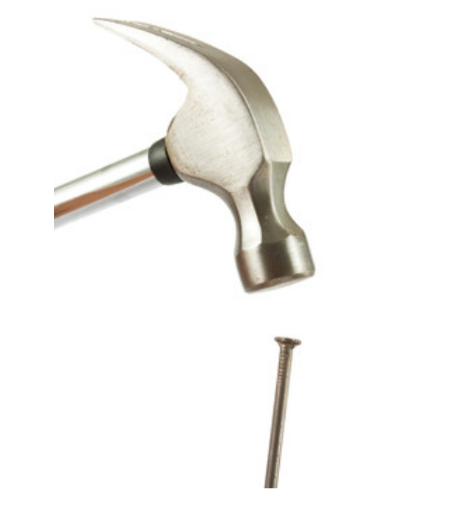
Direct and Manage Project Work is the process of….(p. 90)
“…leading and performing the work defined in the project management plan and implementing approved changes to achieve the project’s objectives.”
(see next slide)

Slide 26

The key benefit.. (p.90)
“…provides overall management of the project work deliverables, and thus improves the probability of project success.”

Slide 27
Involves…
Planned project activities to complete project deliverables
Accomplish established objectives

Slide 28

The Project Manager… (p. 92)
‘’…directs the performance of the planned project activities and manages the various technical and organizational interfaces…” and through monitor-and-control, applies the necessary guidance to ensure the project remains on track.

Slide 29

Project Documents (p. 92)
Requirements
Change requests
Lessons learned register
Milestone list
Project communications:
Action items
Status reports
Issue logs
Assumptions
Known risks
Minutes
Etc.

Slide 30

More Project Documents (p. 93)
Project schedule (HUGE!)
Requirements trackability matrix (RTM; annoying but necessary)*
Risk register (huge! - see final course project for details)
*Example RTM can link the non technical to technical requirements

Slide 31

Deliverables (p. 95)
1
“a deliverable is any unique and verifiable product, result, or capacity to perform a service…”
What you deliver to your customer!

Slide 32
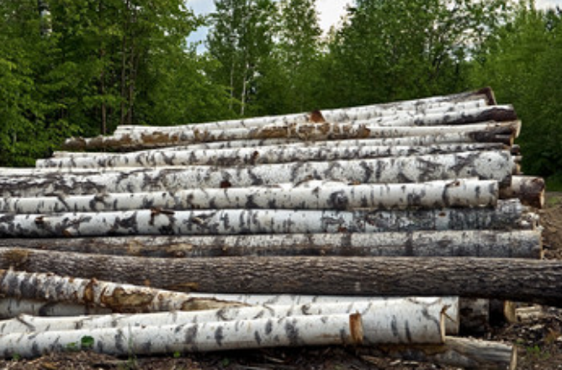
Issue Log – You’ll need to use this (p.96)
Topic – what the issue is
Who identified it
When it was discovered
Priority (high, low, medium -> “Show stopper”(BV))
Who owns the resolution
What happens if the issue is not resolved (BV)
Target closure date
Dates of Status/closure
Use “alt/enter” to build a new line on an excel spreadsheet.
Date every entry, and have a name on every entry
(logs)

Slide 33

Issue vs. Risk(BV)
Risk: something good or bad that might happen
Issue: a known activity that must be dealt with, may be the result of a risk item manifesting itself.

Slide 34

Change requests – why? (p. 96)
Modify:
project policies
Scope
Any baselined document
Cost
Budget
Quality demand
Product results
Requirements
When:
Corrective action
Preventative action
Defect repair
Updates
New information (bv)

Slide 35
4.4 Manage Project Knowledge (p. 98)

Slide 36

Manage Project Knowledge…(p.98)
“...is the process of using existing knowledge and creating new knowledge to achieve the project’s objectives and contribute to organizational learning.”

Slide 37

2 Types of Knowledge (p. 100)
Explicit knowledge (words, pictures, & numbers can express them)
Relatively easy to capture
Relatively easy to share
Tacit (Beliefs, insights, ability & experience)
Hard to share
Stored in minds (typically experts)
Shared through conversations
(like feelings)

Slide 38

Observations on Tacit Knowledge (bv)
Stories shared at the right time to deliver knowledge
First hand experience is trusted more
Expert can gauge what learner is ready to learn
Expert can alter sequence of learning to optimize delivery
People can use body language to express important points
People can be excellent source of on-demand chunks of knowledge

Slide 39

Methods to Share Knowledge (p. 103)
Networking
Communities of practice
Meetings
Work shadowing
Seminars/conferences
Workshops/training/interactive-learning
Story telling (huge!)

Slide 40
Why do I have bad luck with the waterfall Lesson Learned process? (BV)
1
On a predictive/waterfall team there is:
Often no budget to improve business as usual
It is very difficult to convey knowledge from one project environment to another
Once a project is done, the team ends, and knowledge never seems to get passed forward.
“not invented here(NIH)” syndrome (for teams that could use the knowledge)
But, on Scrum teams, they have “retrospectives,” and those actually work.

Slide 41
4.5 Monitor and Control Project Work (p. 105)

Slide 42
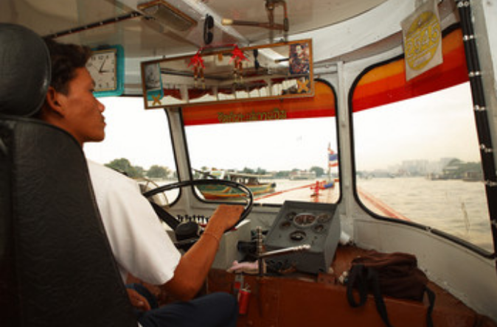
Monitor and control… (p. 105)
…track, review, & report project progress compared to plan.
Value: Allows stakeholders to understand the current state of the project, to recognize the actions taken to address any key performance issues, and to have visibility into the future project status with cost and schedule forecasts.

Slide 43
4.6 Perform Integrated Change Control (p. 113)

Slide 44

Perform Integrated Change Control… (p. 113)
“…is the process of reviewing all change requests; approving changes and managing changes to deliverables, project documents, and the project management plan; and communicating the decisions” to the appropriate stakeholders.
Value: it allows for documented changes within the project to be considered in an integrated manner while addressing overall project risk, which often arises from changes made without consideration of the overall objectives or plans.*

Slide 45

2 failures to react to change, or react fast enough (1 of 2)
The Challenge space shuttle disaster. The unexpected change was a very cold launch pad: https://www.youtube.com/watch?v=Da9QGH_WivM 3Min
Per http://bit.ly/2WgQeQg Jan/’85 - 53 degree Fahrenheit temperature allowed primary “o” ring to fail one year earlier (Allan McDonald) Director of Rocket Booster Project @5:36 min)

Slide 46
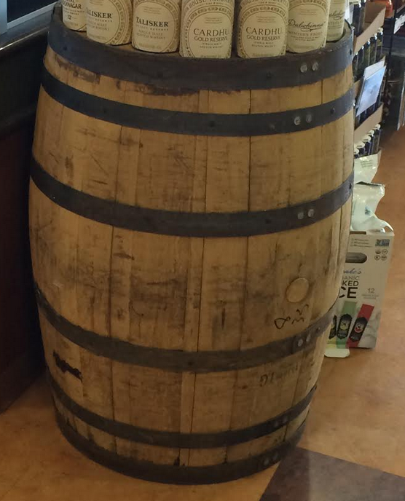
Example 1: What a solid rocket booster looks like under pressure…
Ends get pushed in>>>>>>>
Because middle expands>>>>>
Ends get pushed in>>>>>>>

Slide 47
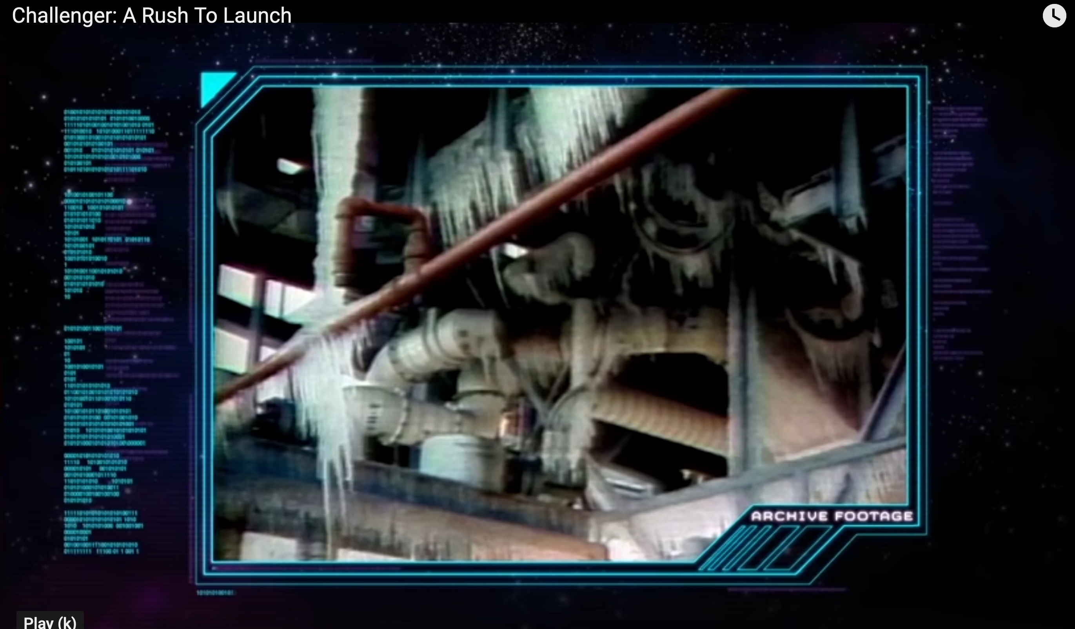
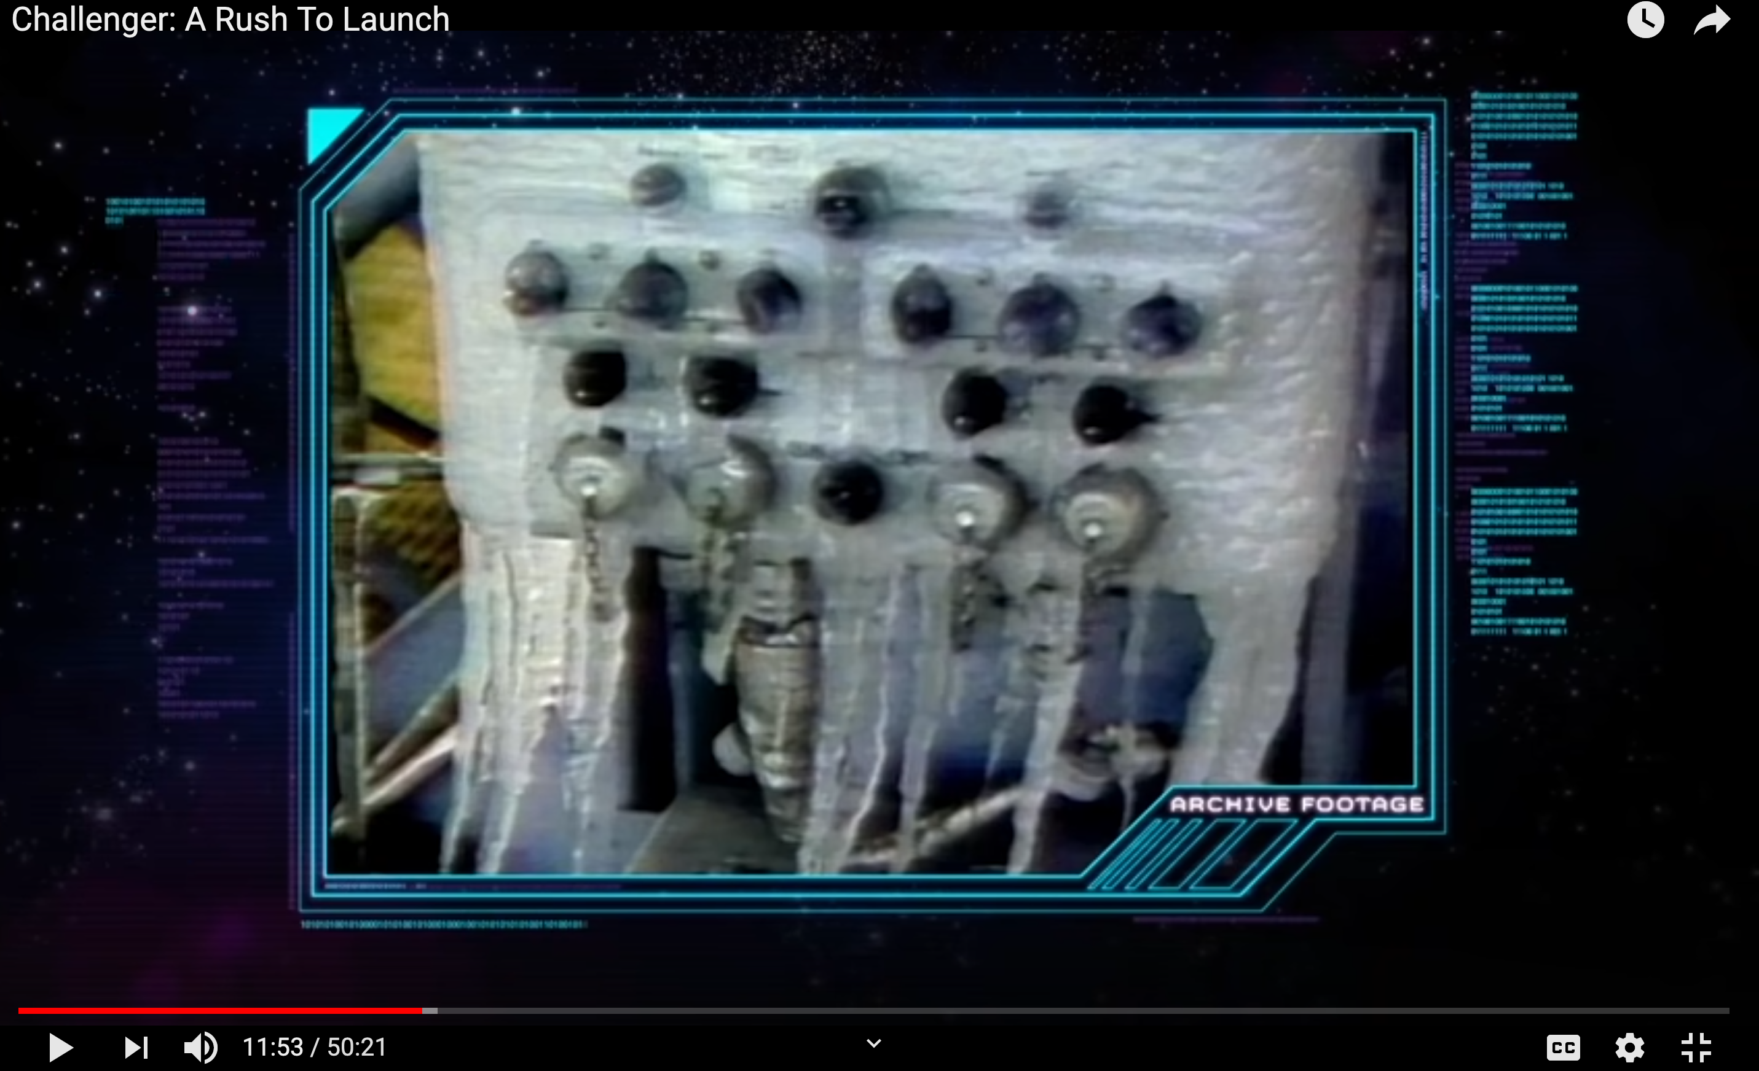
.* http://bit.ly/2WgQeQg . @11:50 min

Slide 48
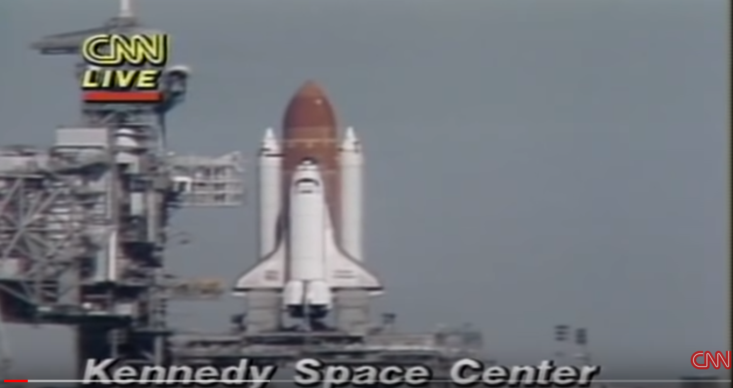
Challenger explosion
Quote from CNN: Space shuttle “is underway after more delays than NASA (the space agency) cares to count.”
Found at (not for watching during class)…. https://www.youtube.com/watch?v=AfnvFnzs91s. (@1:30)

Slide 49
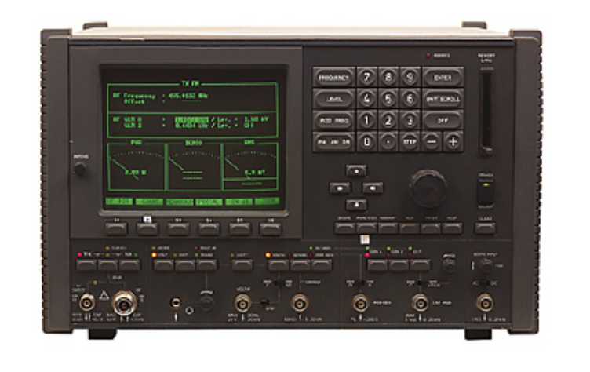
The performance integrated change control process… (p. 115)
“is conducted from project start through completion and is the ultimate responsibility of the project manager.”

Slide 50
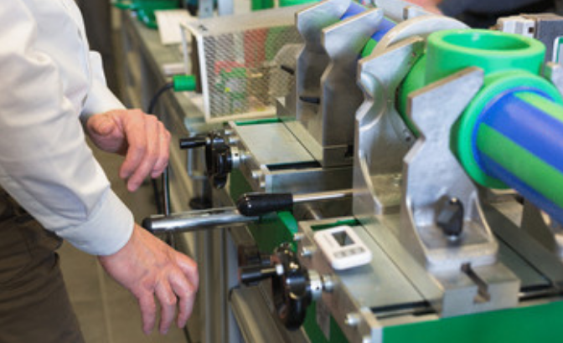
Change control process (p. 119)
Identify
Document
Decide on changes ; “Review changes, approving, rejecting, deferring, or making other decisions about changes to the project documents, deliverables, or baselines.
Track changes:
Identified(BV)
Registered
Assessed (huge!)
Approved
Tracked
Communicate completion

Slide 51

Decision Making (Huge!) P 119
Voting
Autocratic decision making – one person votes for all
Multicriteria decision analysis: the use of a decision matrix to provide an analytical approach to selecting a correct option. (See next slide.)

Slide 52
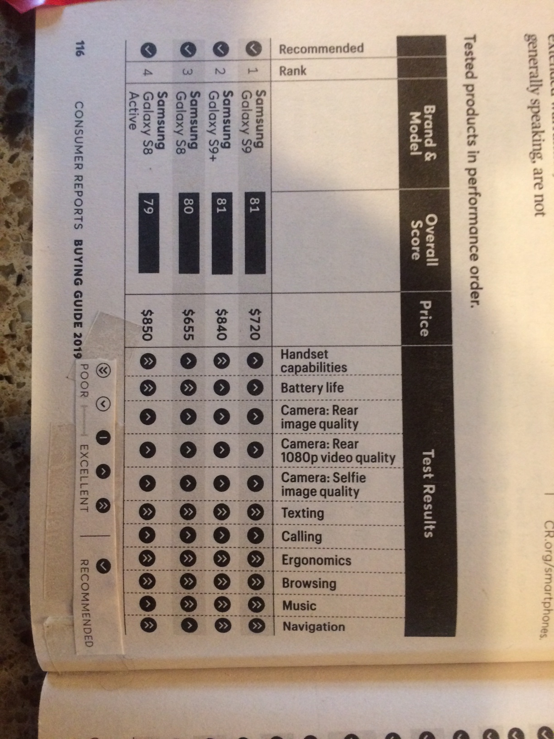
This is an example of “multicriteria decision making”
Comment: Please note; the most expensive phone did not rate the highest.

Slide 53
4.7 Close project of phase (p 121)

Slide 54
Comment from instructor(BV)
This is boring and tedious
But, it can save you a lot of time and money years down the line if you do it right

Slide 55
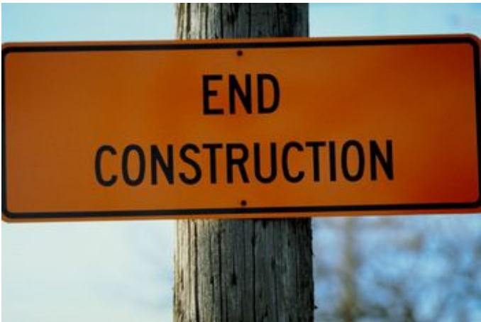
Close project or phase… (p. 121)
“…is the process of finalizing all activities for the project, phase, or contract. ”
Value: “project and phase information is archived, and the planned work is completed, and the organizational team resources are released to pursue (other projects).”

Slide 56

Important (p. 123)
All documents should be up-to-date with all issues resolved
Formal acceptance (especially lean waivers)
All costs are to be charged to the project
Close project accounts
Re-assign personnel
Deal with excess material and scrap
Clean up any environmental mess (bv)
Relocate project facilities, equipment, and other resources

Slide 57

More activities (p 123)
Confirm formal acceptance of work product (huge!)
Update records to indicate final results
Archive project information (very hard to do - bv)

Slide 58
Done

